Slide 1
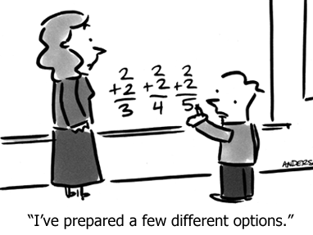
9/10/15
Happy Thursday!
Please take out the Exponents G.O.

Slide 2
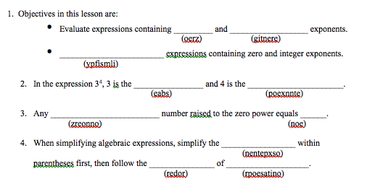
Vocab Scramble Warm Up

Slide 3
Exponents
EQ: How are expressions with exponents simplified?
Khan video

Slide 4
Let’s practice!
= 2 • 2 • 2 • 2 • 2
= (-3) • (-3) • (-3)

Slide 5


Power of 1
Remember…
n¹ = itself
n can be any number

Slide 6
Can anyone think of what the “invisible” exponent may be?
Any nonzero number raised to the power of 1 is equal to itself!
Examples:
3¹ = ?
6y = ?

Slide 7
Multiplying Exponents
= b • b • b • b • b
When multiplying two bases that are the same, you add exponents.
Multiplying Powers Rule

Slide 8
Let’s practice!
4⁵ • 4⁷
    = 4⁵⁺⁷
    = 4¹²
y¹² • y³
    = y¹⁵
2r ⁴ • 4r ⁻³
    = 8r¹ or 8r
3k¹⁰ • 6k ⁻¹³
    = 18k⁻³

Slide 9
Dividing Exponents
a • a • a • a • a • a
a • a • a • a
a⁶ =
a⁴
= a²
= a^{6 – 4}
When dividing two bases that are the same, you subtract exponents.
Division of Powers Rule

Slide 10
Let’s Practice!
5⁶
5⁻⁷
    = 5¹³
y⁶
y⁰
c⁻⁷
c⁴
= y⁶
= 5^{6 – (-7)}
= c⁻¹¹
There’s something special when there is a negative in the exponent! We will go back to this problem tomorrow!

Slide 11
Let’s practice!

Slide 12
Ticket Out The Door
Finish each sentence:
When multiplying two bases that are the same, you….
When dividing two bases that are the same, you….

Slide 13
Review… Any nonzero number raised to the “0” power is equal to .
one
1
13⁰ =
1,245,607,123⁰ =
2,347¹ =
1
2,347

Slide 14
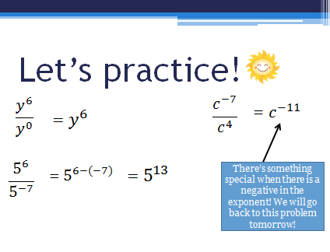
Remember this problem from yesterday…?

Slide 15
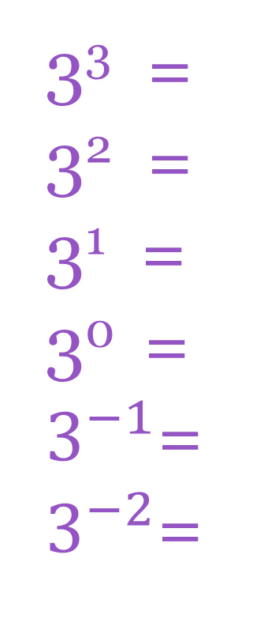
Let’s learn what to do when we have negative exponents!
3³ =
3² =
3¹ =
3⁰ =
$3^{−1}$=
$3^{−2}$=
27
÷ 3
9
Proves why
n¹ = n and
n⁰ = 1
÷ 3
3
÷ 3
1
÷ 3
3⁻¹ =
3⁻² =
1/3
÷ 3
1/9

Slide 16
So… how can negative exponents become positive?
Find the reciprocal (flip the ratio) and then the exponent becomes positive!
Ex. 3⁻⁴
Negative Power Rule

Slide 17
Let’s practice!
Simplify:
5 ⁻³
c ⁻¹¹
k ⁻⁷

Slide 18
More Multplying
When we raise a power to another power…
like (x³)²
… we multiply the exponents!
(x³)²
= x³•x³
= x⁶
Power to a Power Rule

Slide 19
Let’s practice!
(c⁴) ³
(t⁷) ⁵
(4⁻²) ²

Slide 20
Let’s practice!

Slide 21
More Multplying
To find the power of a product…
… we distribute the exponent and follow multiplication rules!
(2x⁵)²
= 2^{1×2}•x^{5×2}
= 4x¹⁰
Power of a Product

Slide 22
You try the ones on your GO…
c⁻²
3⁻²

Slide 23
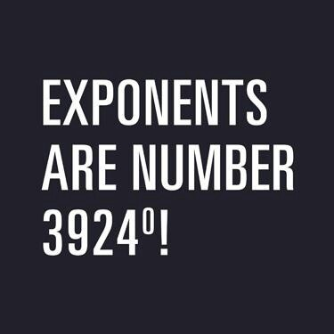
Warm Up:
Explain to your neighbor what this picture means.

Slide 24
Let’s practice!

Slide 25
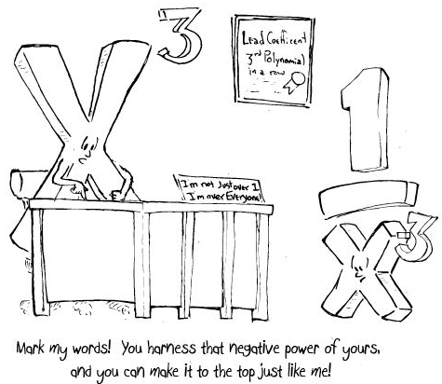
Ticket Out The Door: Explain to your neighbor what this cartoon means.

