Slide 1
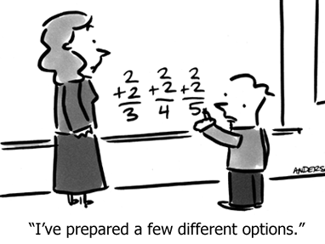
Warm Up:
Use your GO that you started on Friday to fill in your word scramble!

Slide 2
9/2/14
After you write down the HW for the week in your agenda, try to fill in the word scramble!

Slide 3
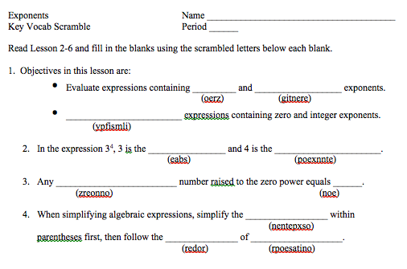
Vocab Scramble Warm Up

Slide 4
Anticipation Guide: Exponents
D
x³x⁴ = x¹²
(x³)⁴ = x¹²
x² + x²= 2x²
x² + x²= 2x⁴
(2x²)(2x²) = 4x²
(x+y)² = x² + y²
x³y³ = (xy)³
A
A
A
D
Write your TOTAL number CORRECT under the column
D
D
A

Slide 5
Exponents
EQ: How are expressions with exponents simplified?
Khan video

Slide 6
Let’s practice!
= 2 • 2 • 2 • 2 • 2
= (-3) • (-3) • (-3)

Slide 7


Power of 1
Remember…
n¹ = itself
n can be any number

Slide 8
Can anyone think of what the “invisible” exponent may be?
Any nonzero number raised to the power of 1 is equal to itself!
Examples:
3¹ = ?
6y = ?

Slide 9
Multiplying Exponents
= b • b • b • b • b
When multiplying two bases that are the same, you add exponents.
Multiplying Powers Rule

Slide 10
Let’s practice!
t⁵ • t⁷
    = t⁵⁺⁷
    = t¹²
y¹² • y³
    = y¹⁵
2r ⁴ • 4r ⁻³
    = 8r¹ or 8r
3k¹⁰ • 6k ⁻¹³
    = 18k⁻³

Slide 11
Dividing Exponents
a • a • a • a • a • a
a • a • a • a
a⁶ =
a⁴
= a²
= a^{6 – 4}
When dividing two bases that are the same, you subtract exponents.
Division of Powers Rule

Slide 12
Let’s Practice!
5⁶
5⁻⁷
    = 5¹³
y⁶
y⁰
c⁻⁷
c⁴
= y⁶
= 5^{6 – (-7)}
= c⁻¹¹
There’s something special when there is a negative in the exponent! We will go back to this problem tomorrow!

Slide 13
Let’s practice!

Slide 14
Ticket Out The Door
Finish each sentence:
When multiplying two bases that are the same, you….
When dividing two bases that are the same, you….

Slide 15
9-3-14
Simplify:
HW CHECK TODAY!
k⁻⁷ • k³
Tell your neighbor:
When multiplying two bases that are the same, you….
When dividing two bases that are the same, you….

Slide 16
Any nonzero number raised to the “0” power is equal to .
one
1
13⁰ =
1,245,607,123⁰ =
2,347¹ =
1
2,347

Slide 17
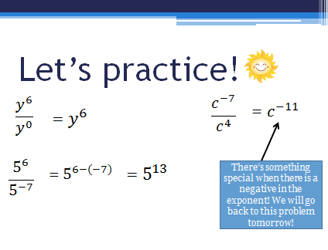
Remember this problem from yesterday…?

Slide 18
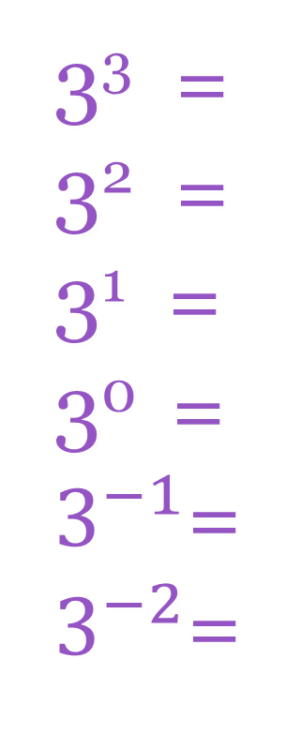
Let’s learn what to do when we have negative exponents!
3³ =
3² =
3¹ =
3⁰ =
$3^{−1}$=
$3^{−2}$=
27
÷ 3
9
Proves why
n¹ = n and
n⁰ = 1
÷ 3
3
÷ 3
1
÷ 3
3⁻¹ =
3⁻² =
1/3
÷ 3
1/9

Slide 19
So… how can negative exponents become positive?
Find the reciprocal (flip the ratio) and then the exponent becomes positive!
Ex. 3⁻⁴
Negative Power Rule

Slide 20
Let’s practice!
Simplify:
5 ⁻³
c ⁻¹¹
k ⁻⁷

Slide 21
One last rule!
When we raise a power to another power…
like (x³)²
… we multiply the exponents!
(x³)²
= x³•²
= x⁶
Power to a Power Rule

Slide 22
Let’s practice!
(c⁴) ³
(t⁷) ⁵
(4⁻²) ²

Slide 23
Let’s practice!

Slide 24
Ticket Out The Door:
Simplify this expression:

Slide 25
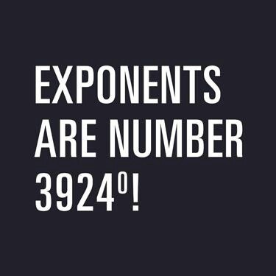
Warm Up:
Explain to your neighbor what this picture means.

Slide 26
Let’s practice!

Slide 27
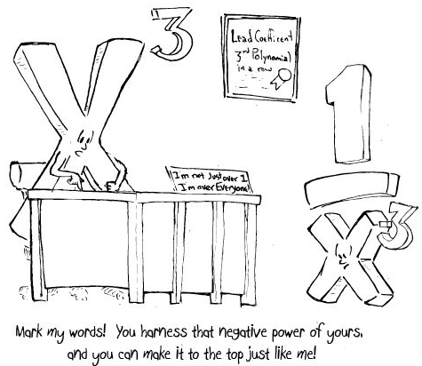
Ticket Out The Door: Explain to your neighbor what this cartoon means.

Slide 28
Anticipation Guide: Exponents
x³x⁴ = x¹²
(x³)⁴ = x¹²
x² + x²= 2x²
x² + x²= 2x⁴
(2x²)(2x²) = 4x²
x⁰ = 0
x³y³ = (xy)³
D
A
A
A
D
D
D
A

